Slide 1


Slide 2
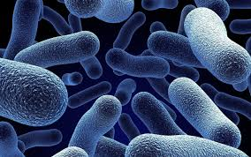
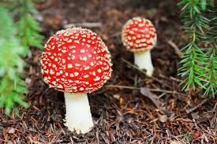

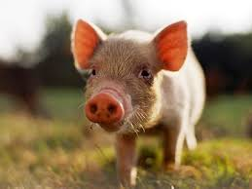
Bringing the Cyc to BioCyc
MetaCyc is an ambitious project, aiming to catalog all known information about metabolism
A metabolic encyclopedia for people and information systems
Foundation for all other BioCyc databases

Slide 3
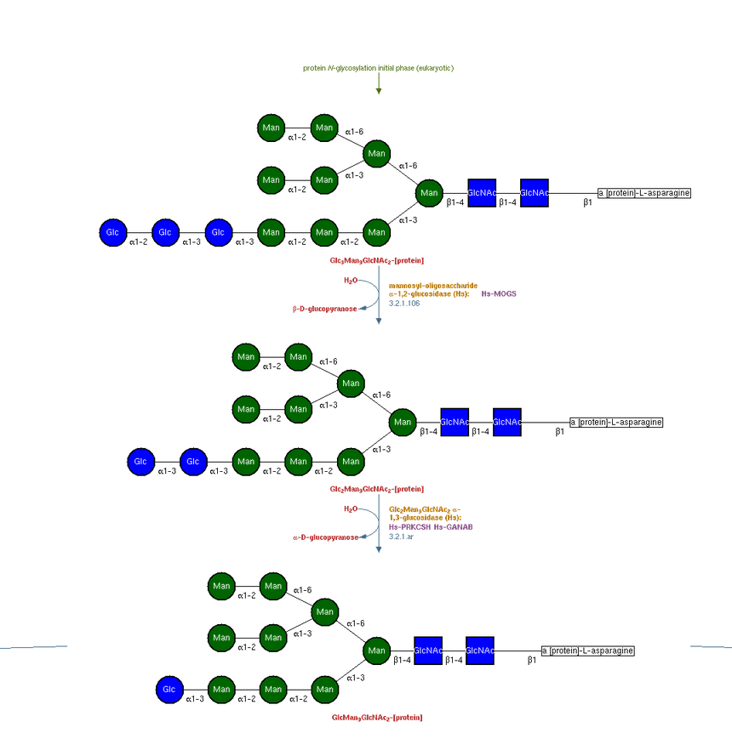
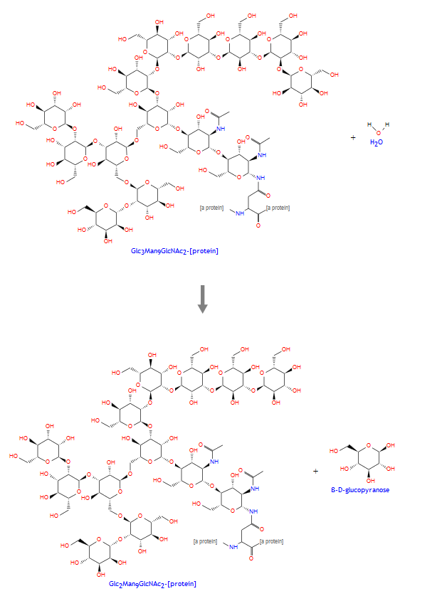
Naming enzymes is not always simple
[α-D-Glc-(1→2)-α-D-Glc-(1→3)-α-D-Glc-(1→3)-α-D-Man-(1→2)-α-D-Man-(1→2)-α-D-Man-(1→3)-{α-D-Man-(1→2)-α-D-Man-(1→3)-[α-D-Man-(1→2)-α-D-Man-(1→6)]-α-D-Man-(1→6)}-β-D-Man-(1→4)-β-D-GlcNAc-(1→4)-β-D-GlcNAc]-N-Asn-[protein] + H2O = [α-D-Glc-(1→3)-α-D-Glc-(1→3)-α-D-Man-(1→2)-α-D-Man-(1→2)-α-D-Man-(1→3)-{α-D-Man-(1→2)-α-D-Man-(1→3)-[α-D-Man-(1→2)-α-D-Man-(1→6)]-α-D-Man-(1→6)}-β-D-Man-(1→4)-β-D-GlcNAc-(1→4)-β-D-GlcNAc]-N-Asn-[protein] + β-D-glucopyranose
Glc3Man9NAc₂ oligosaccharide glucosidase; trimming glucosidase I; CWH41; MOGS; mannosyl-oligosaccharide glucohydrolase
or - EC 3.2.1.106

Slide 4
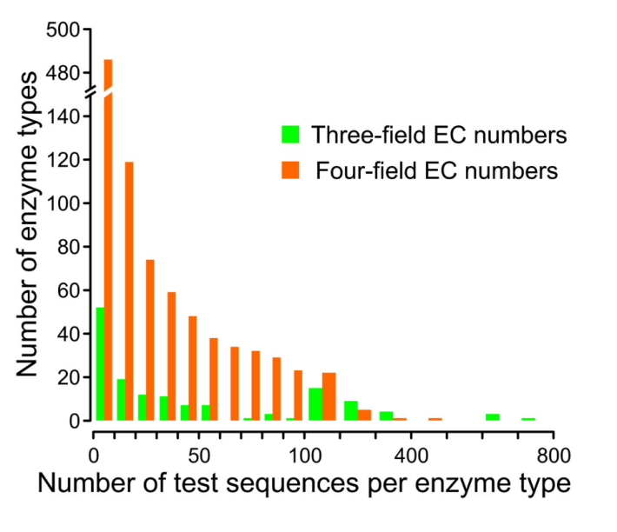
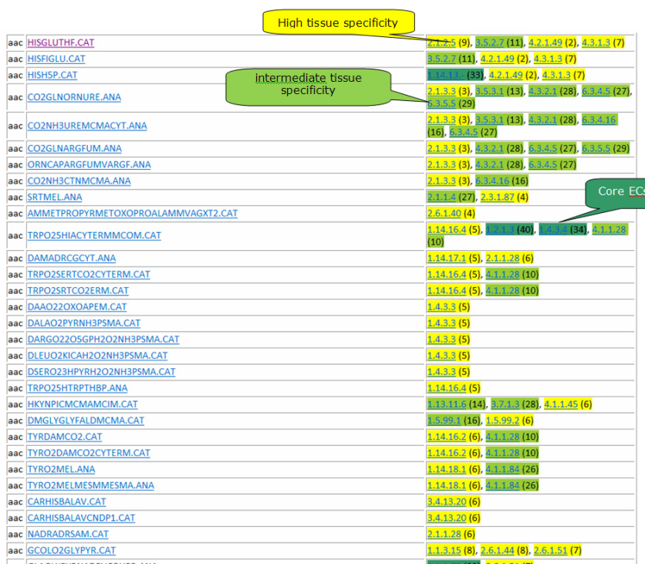
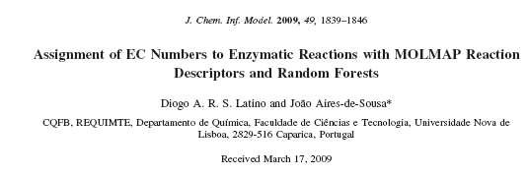
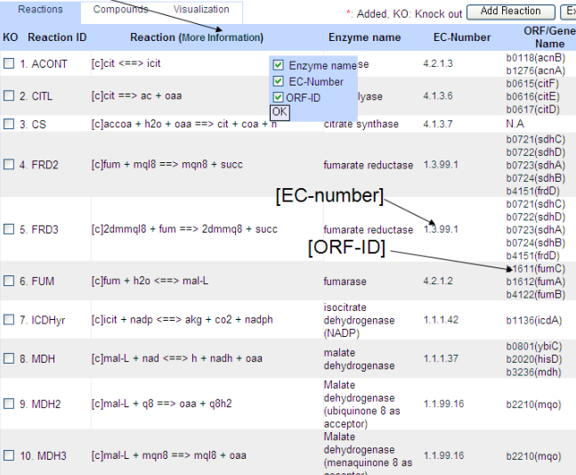
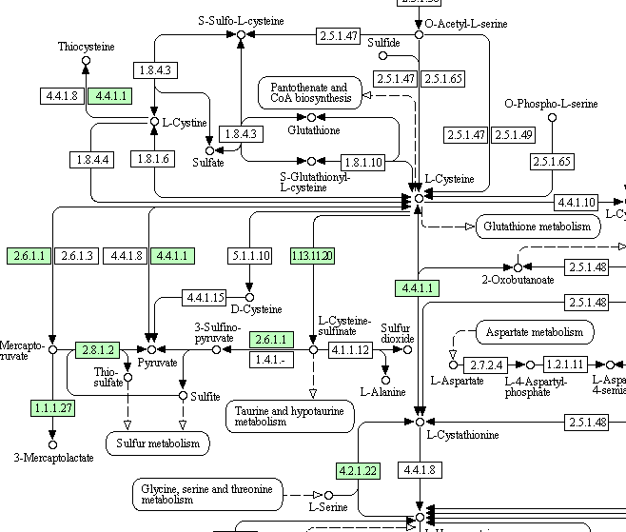
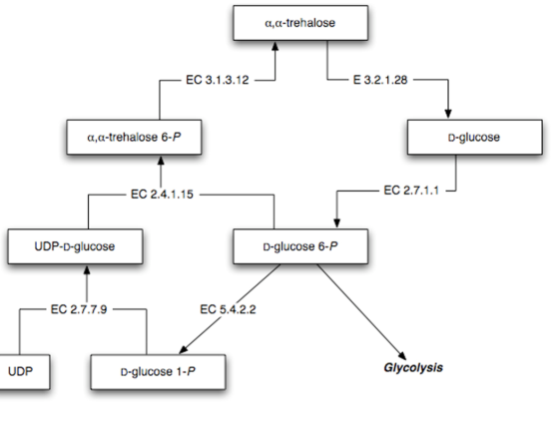
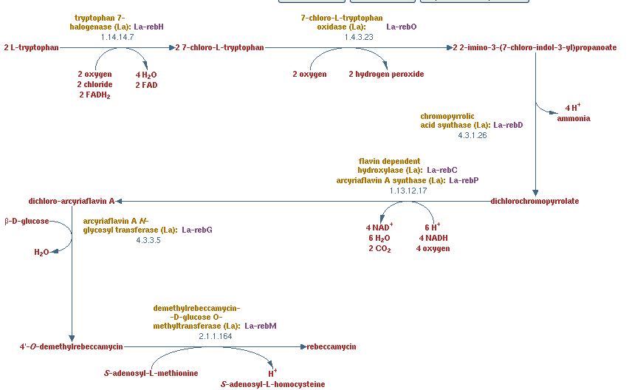

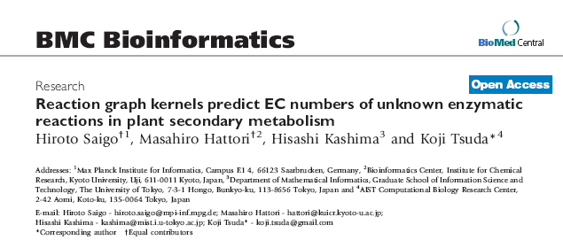
EC Numbers Are Everywhere

Slide 5
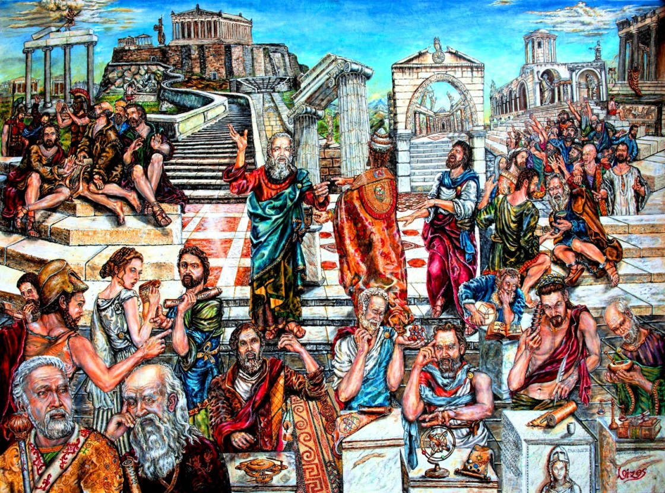
Historical Background

Slide 6



Back in the 1950s
The number of known enzymes was increasing rapidly
No guiding authority
The same enzymes became known by several different names, and
The same name was sometimes given to different enzymes
Names often conveyed little or no idea of the nature of the reactions catalyzed

Slide 7

The Situation Was Chaotic…
Catalase (also known as equilase, caperase, optidase…)
Diaphorase (dehydrogenase)
Zwischenferment (glucose-6-phosphate dehydrogenase)
methyl viologen-nitrite reductase
old yellow enzyme
Zwischenferment
Catalase
diaphorase
Notes:
“Diaphoros” in Greek is “different”
“Zwischen” in German is “in between”

Slide 8
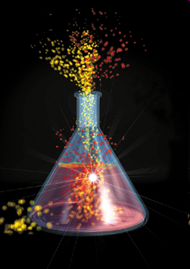
The International Enzyme Commission To The Rescue!
1955: The International Union of Biochemistry (IUB) sets up an International Enzyme Commission to tackle the problems
(yes – it’s even older than PDB!)
The Basic Concept:
Enzymes should be classified
and named by the reactions
they catalyze

Slide 9
The EC Number
In addition to an established name, each enzyme is given a unique four-digit code, known as the Enzyme Commission, or EC, number, that classifies it
EC 1.1.1.1
main class
subclass
sub-subclass
serial number

Slide 10
The Six Main Classes of Enzymes
EC 1.1.1.1
Class | Name | Reaction catalyzed
1 | Oxidoreductases | AH₂ + B = A + BH₂
2 | Transferases | AX + B = A + BX
3 | Hydrolases | A–B + H₂O = AH + BOH
4 | Lyases | A–B = A + B
5 | Isomerases | A = B
6 | Ligases | NTP + A + B = NDP + P + A–B or NTP + A + B = NMP + PP + A–B

Slide 11


The Early Enzyme Commissions
1961: The first EC list (712 entries) was presented at the General Assembly of the IUB in Moscow
1964: The second EC list (875 entries)
1969: The Expert Committee on Enzymes
1972: the third EC list (1770 entries)

Slide 12



1977: Move to NC-IUB
A more permanent solution was needed
In 1977 a new nomenclature committee were formed:
  The IUPAC-IUB Joint Commission on Biochemical Nomenclature (JCBN)
  A subcommittee of JCBN, the new “Nomenclature Committee of IUB” (NC-IUB), assumed responsibility for the EC list

Slide 13



Current Status
Ongoing curation by the NC-IUBMB since 1977
Last printed version (6th edition) published in 1992 (3196 entries)
Transition from print to online content
Currently there are 6087 entries
Current Members:
  K.F. Tipton, Ireland (Trinity College Dublin) – historical perspective
  A. McDonald, Ireland (Trinity College Dublin) – Database and website development
  G.P. Moss, UK (Queen Mary University of London) – chemical nomenclature
  K. Axelsen, Denmark (UniProt) – active curation
  I. Schomburg, Germany (BRENDA) – active curation
  R. Caspi, USA (MetaCyc) – active curation

Slide 14


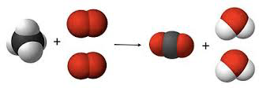
Meanwhile – the Bioinformatics revolution!
EC numbers are a simple way to connect genomic information with biochemical information
Annotation of EC numbers
EC numbers are more relevant than ever before
Notes:
Keith has been in JCBN since 1985

Slide 15

EC Curation

Slide 16
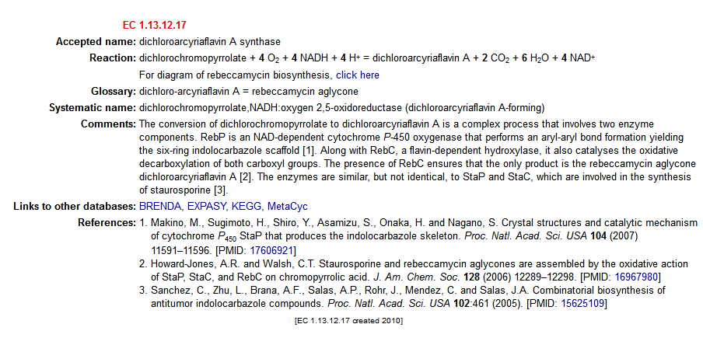
An EC Entry Example

Slide 17
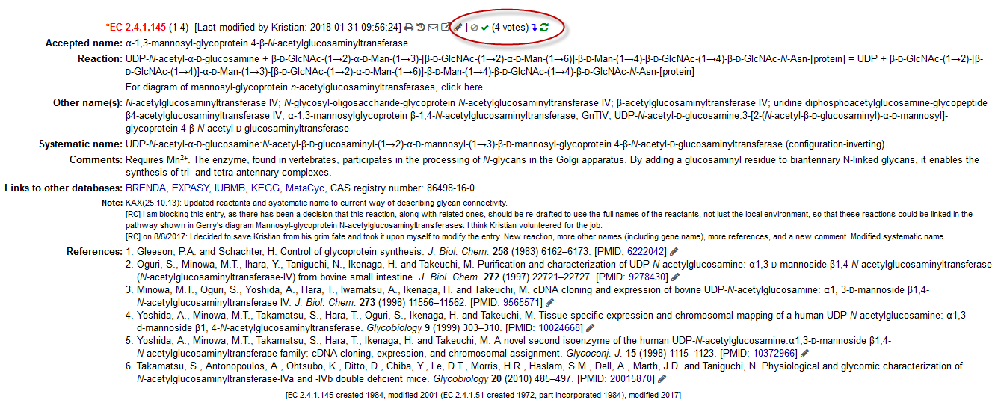
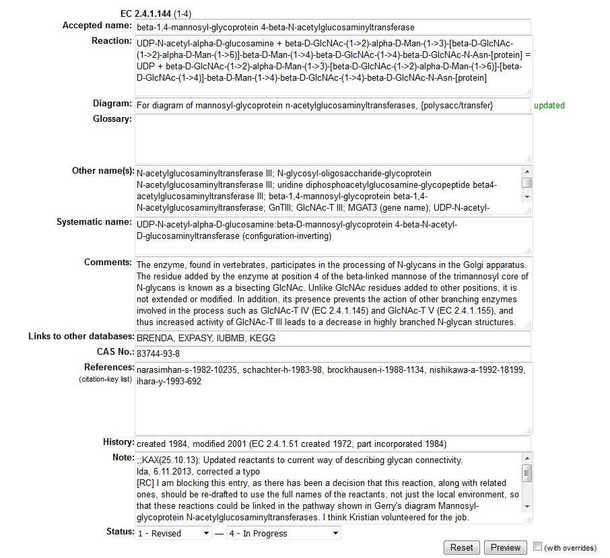
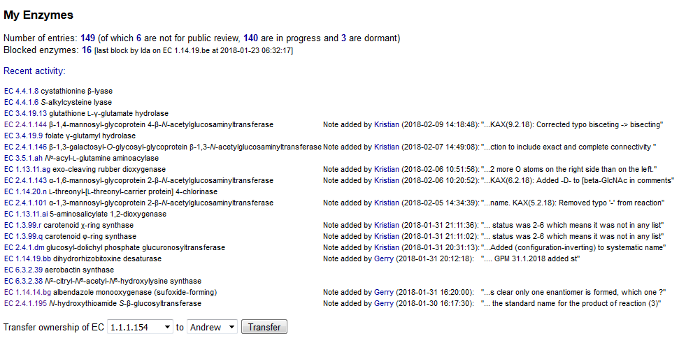
The DraftEnz Portal

Slide 18
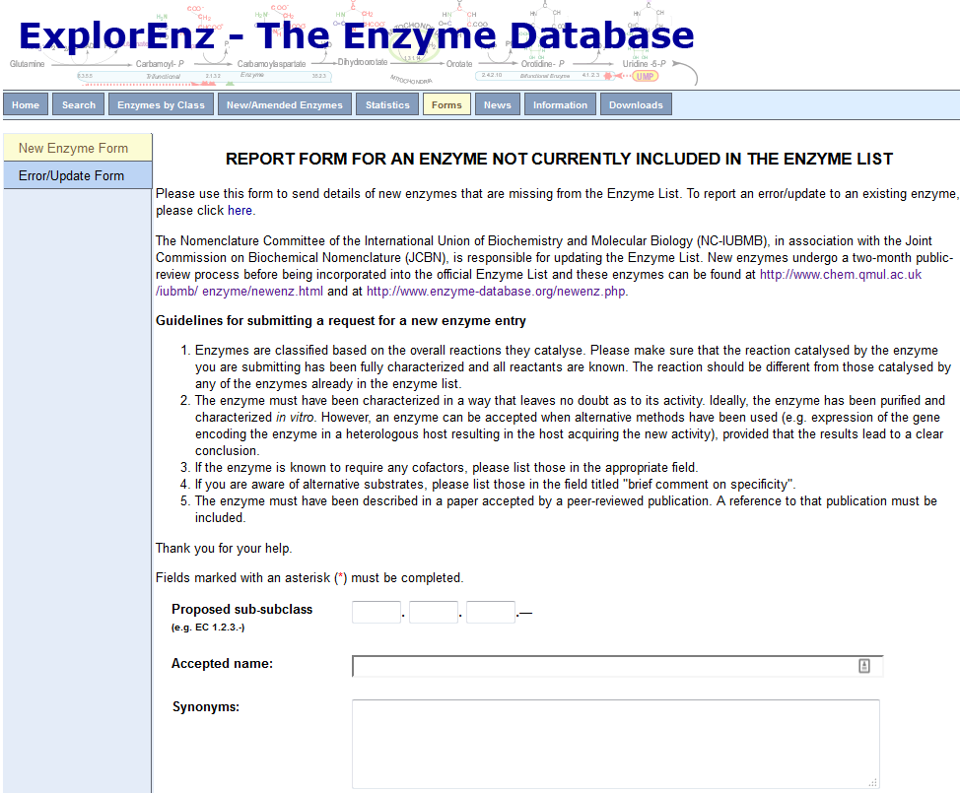
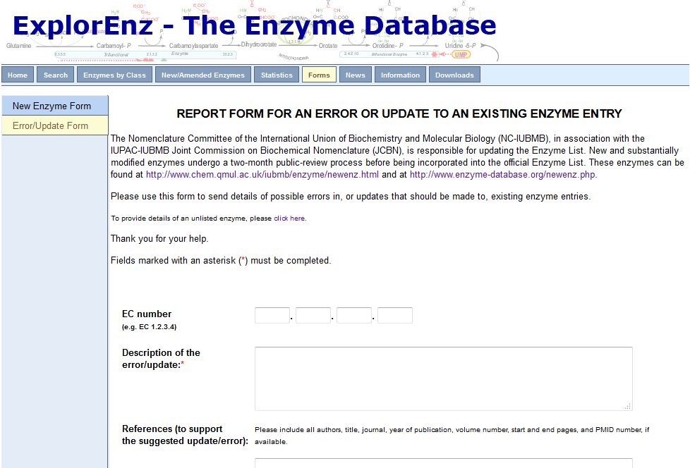
Which Enzymes Are Classified?
Existing entries in pathway/enzyme databases
Curators encounter new enzymes during their regular work
Users requests via websites
Requirements:
The enzyme must have been characterized in a way that leaves no doubt as to its activity.
The enzyme must have been described in a paper accepted by a peer-reviewed publication

Slide 19

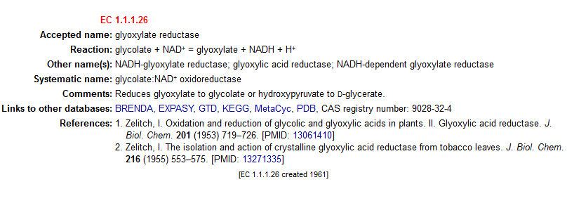
Reaction Direction
EC entries do not imply a direction
For consistency, all reactions in a given
class are written in the same direction
The systematic names are derived from the written direction, even if only the reverse direction has been demonstrated experimentally. Ideally, a comment would indicate that…

Slide 20
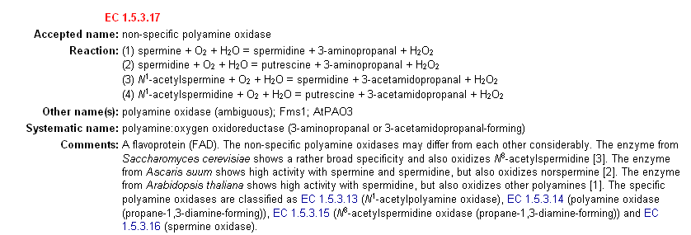
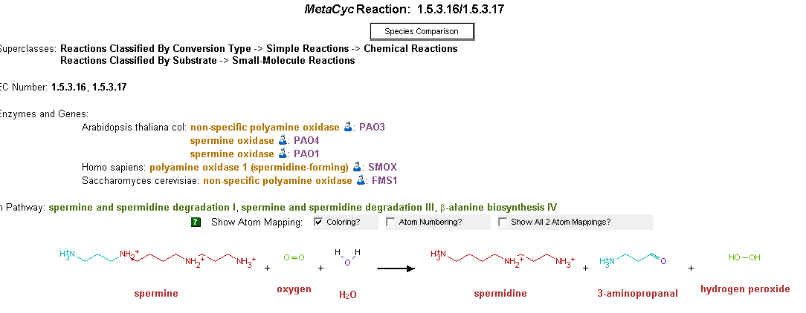
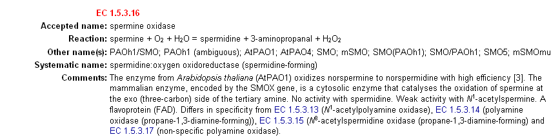
EC Numbers Define Enzymes, Not Reactions!
More accurately, an EC number stands for an active site. Enzymes with multiple active sites (e.g. if several genes fuse to encode a single polypeptide) receive multiple EC numbers.
On the other hand, a reaction may be associated with multiple EC numbers

Slide 21
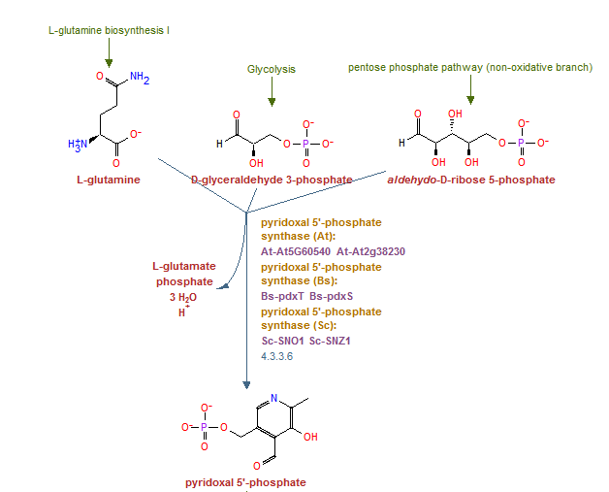

Difficulties
No enzyme can be tested with all potential substrates…
Enzymes that perform very complex reactions
Enzymes with a very broad substrate range (liver alcohol dehydrogenase)
Old enzymes with a single reference - are they real?

Slide 22

Using the EC System

Slide 23





Where Is the EC List?
The primary source is
A daily-updated MySQL database available at
http://www.enzyme-database.org/
Another database, prepared by Gerry Moss, is available at http://www.chem.qmul.ac.uk/iubmb/enzyme/
A copy of the EC list is available via the ENZYME DB (SIB) at http://www.expasy.ch/enzyme/
Yet another one is IntEnz at (EBI-SIB) http://www.ebi.ac.uk/intenz/index.jsp
The EC list is also included in databases such as MetaCyc, BRENDA, KEGG etc.

Slide 24
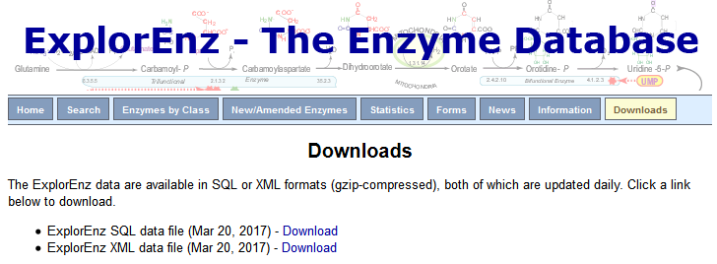

Obtaining the EC Data Is Easy

Slide 25
Growth of the EC List
In the last 7 years the Enzyme Commission has created or revised 2753 entries, a significant fraction of the current 6087 total entries.

Slide 26
Propagation of New EC Numbers
(data gathered in March 2017)
Introduced | EC Number | MetaCyc | Uniprot | KEGG | MicroScope | KBASE | EC2GO
2013 | 3.2.1.185 | + | + | + | + | + | -
2013 | 6.3.4.22 | + | + | + | + | + | -
2014 | 1.1.1.373 | + | + | + | - | - | +
2014 | 5.1.3.29 | + | + | + | + | - | -
2015 | 1.5.1.49 | + | + | + | - | - | -
2015 | 5.1.1.20 | + | + | + | - | - | -
2016 | 1.2.5.3 | + | + | - | + | - | -

Slide 27
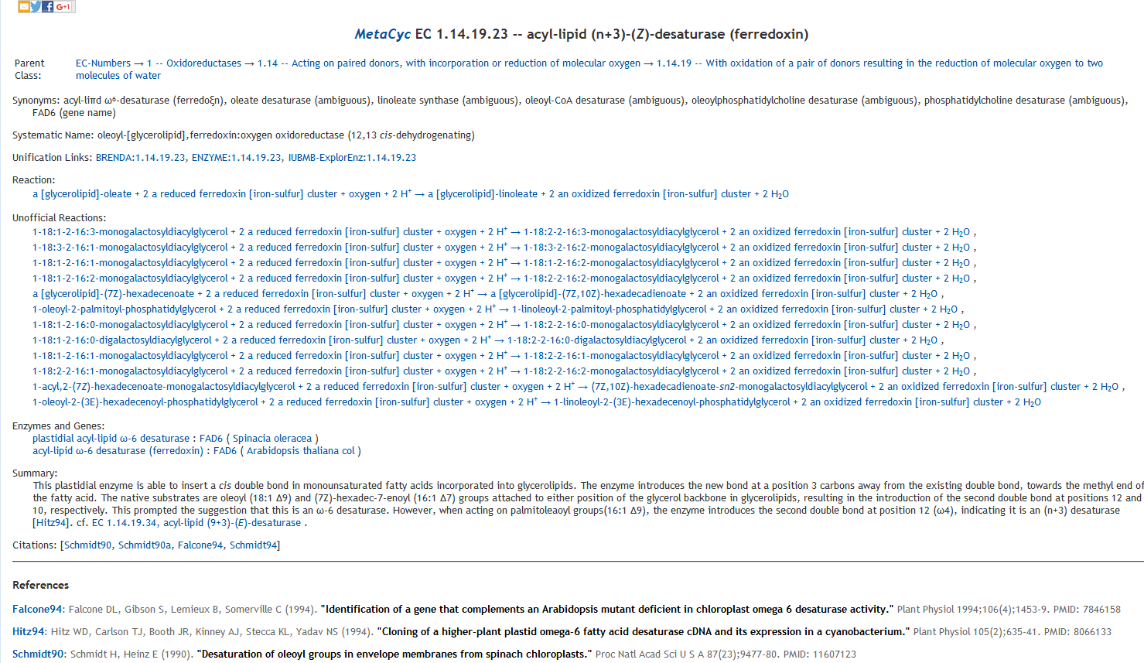
EC Numbers Representation in MetaCyc

Slide 28
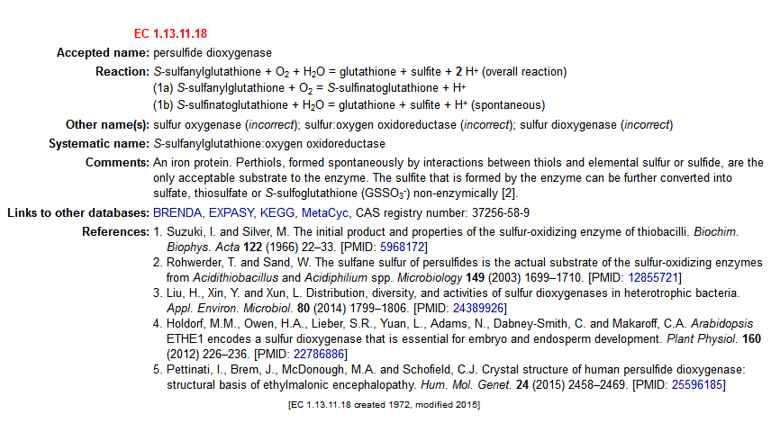
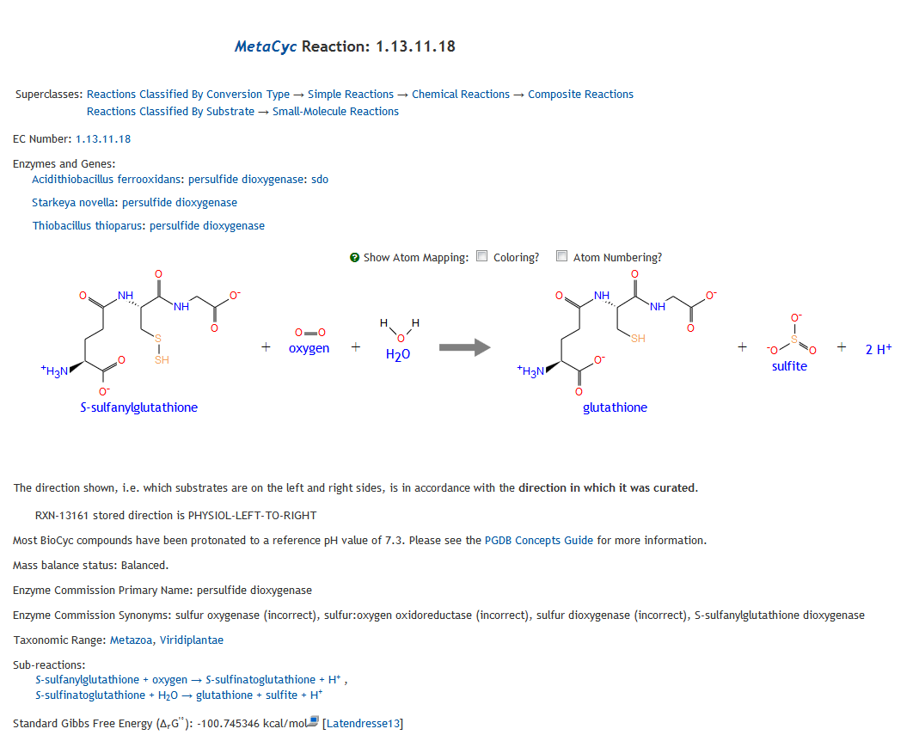
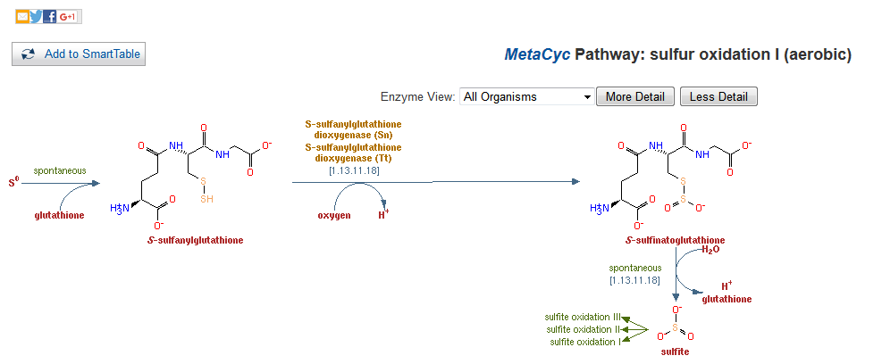
EC Numbers With Composite Reactions

Slide 29
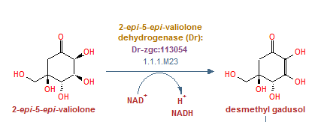
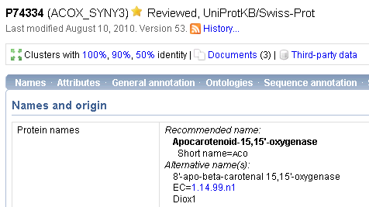
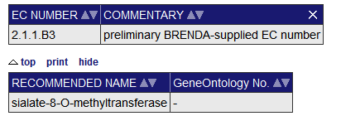
Partial and Provisory EC Numbers
Partial EC numbers look like EC numbers except one or more numbers are replaced by a dash, e.g. 2.1.1.-
Partial EC numbers can describe partial knowledge (e.g. 2.1.1.- for an uncharacterized methyltransferase)
Provisory numbers are given to characterized enzymes that have not been classified yet, and should use the 2.3.4.Nx (or similar) format
BRENDA
MetaCyc
UniProt

Slide 30

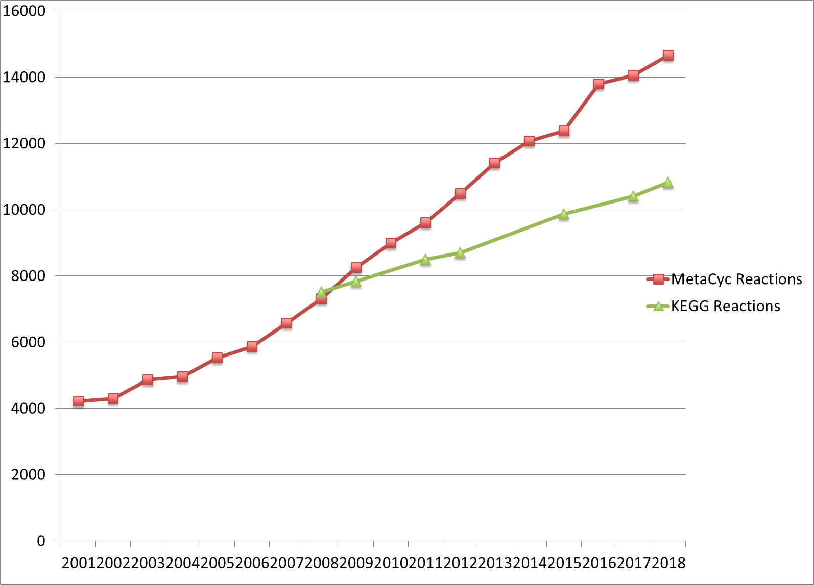
Blatant Advertisement
In case you were wondering where KEGG and MetaCyc are heading…

Slide 31


Conclusions and Thanks
EC Numbers are still very useful
All annotation pipelines should use them
Propagation of new EC numbers to annotation pipelines could be improved
Expansion of the EC list is still slower than desired
Thanks to IUBMB for funding the Enzyme Commission

